Slide 1
Flatmate Expense Tracker
Gokul Jayavel
Hariharan Raj Shankar Raj
Mohan Raj Addluru
Rajkumar Kumaravelu

Slide 2

PURPOSE
Flatmate Expense Tracker helps to track people’s expenses residing in a single flat.
Allows Flatmates to record their expenses on a group basis and divide it among themselves.
The application allows Flatmates to create individual sessions that enable them to record and track their personal expenses and budget.
The personal expenses recorded by the individual user will be private to that particular user and cannot be viewed by other flatmates

Slide 3







TECH STACK

Slide 4
WORKFLOW
The user has to create a room in the application by registering with an email address.
Email verification will be sent for confirmation.
After verification, a room for the flat will be created.
This is followed by creating an individual profile for the Flatmate of the flat using their email and password.
After creating an individual profile, users can log in to the application to add and track their personal and group expenses and budgets.

Slide 5
FEATURES
Register and Login Functionality
Email notification for recurring expenses to user
Authentication
Authorization
CRUD operations
Analytics display
User-friendly and easy application

Slide 6
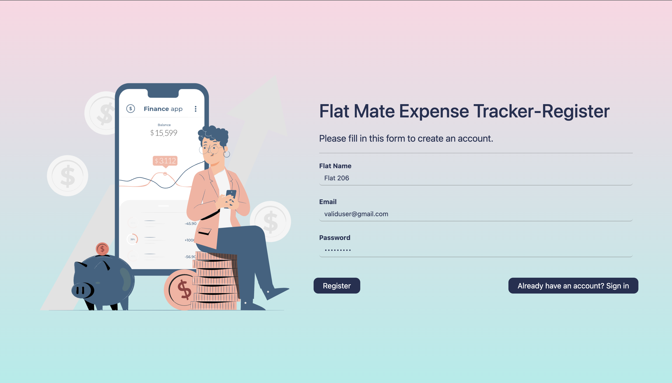
REGISTER PAGE

Slide 7
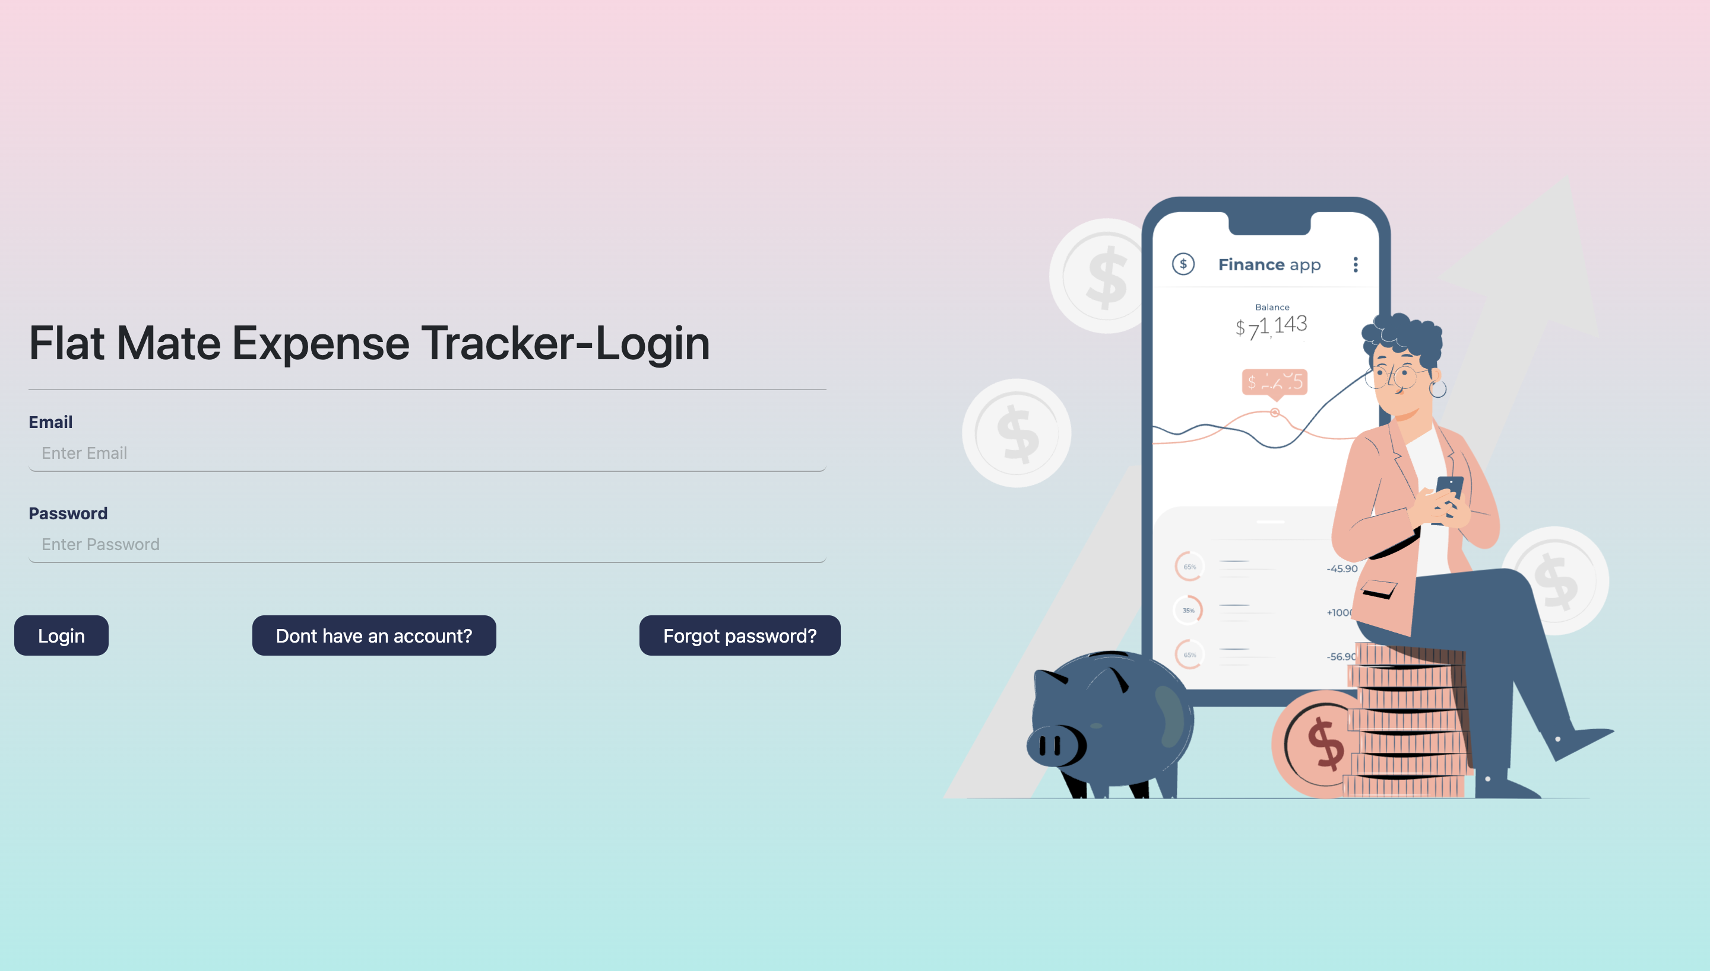
FLAT LOGIN PAGE

Slide 8
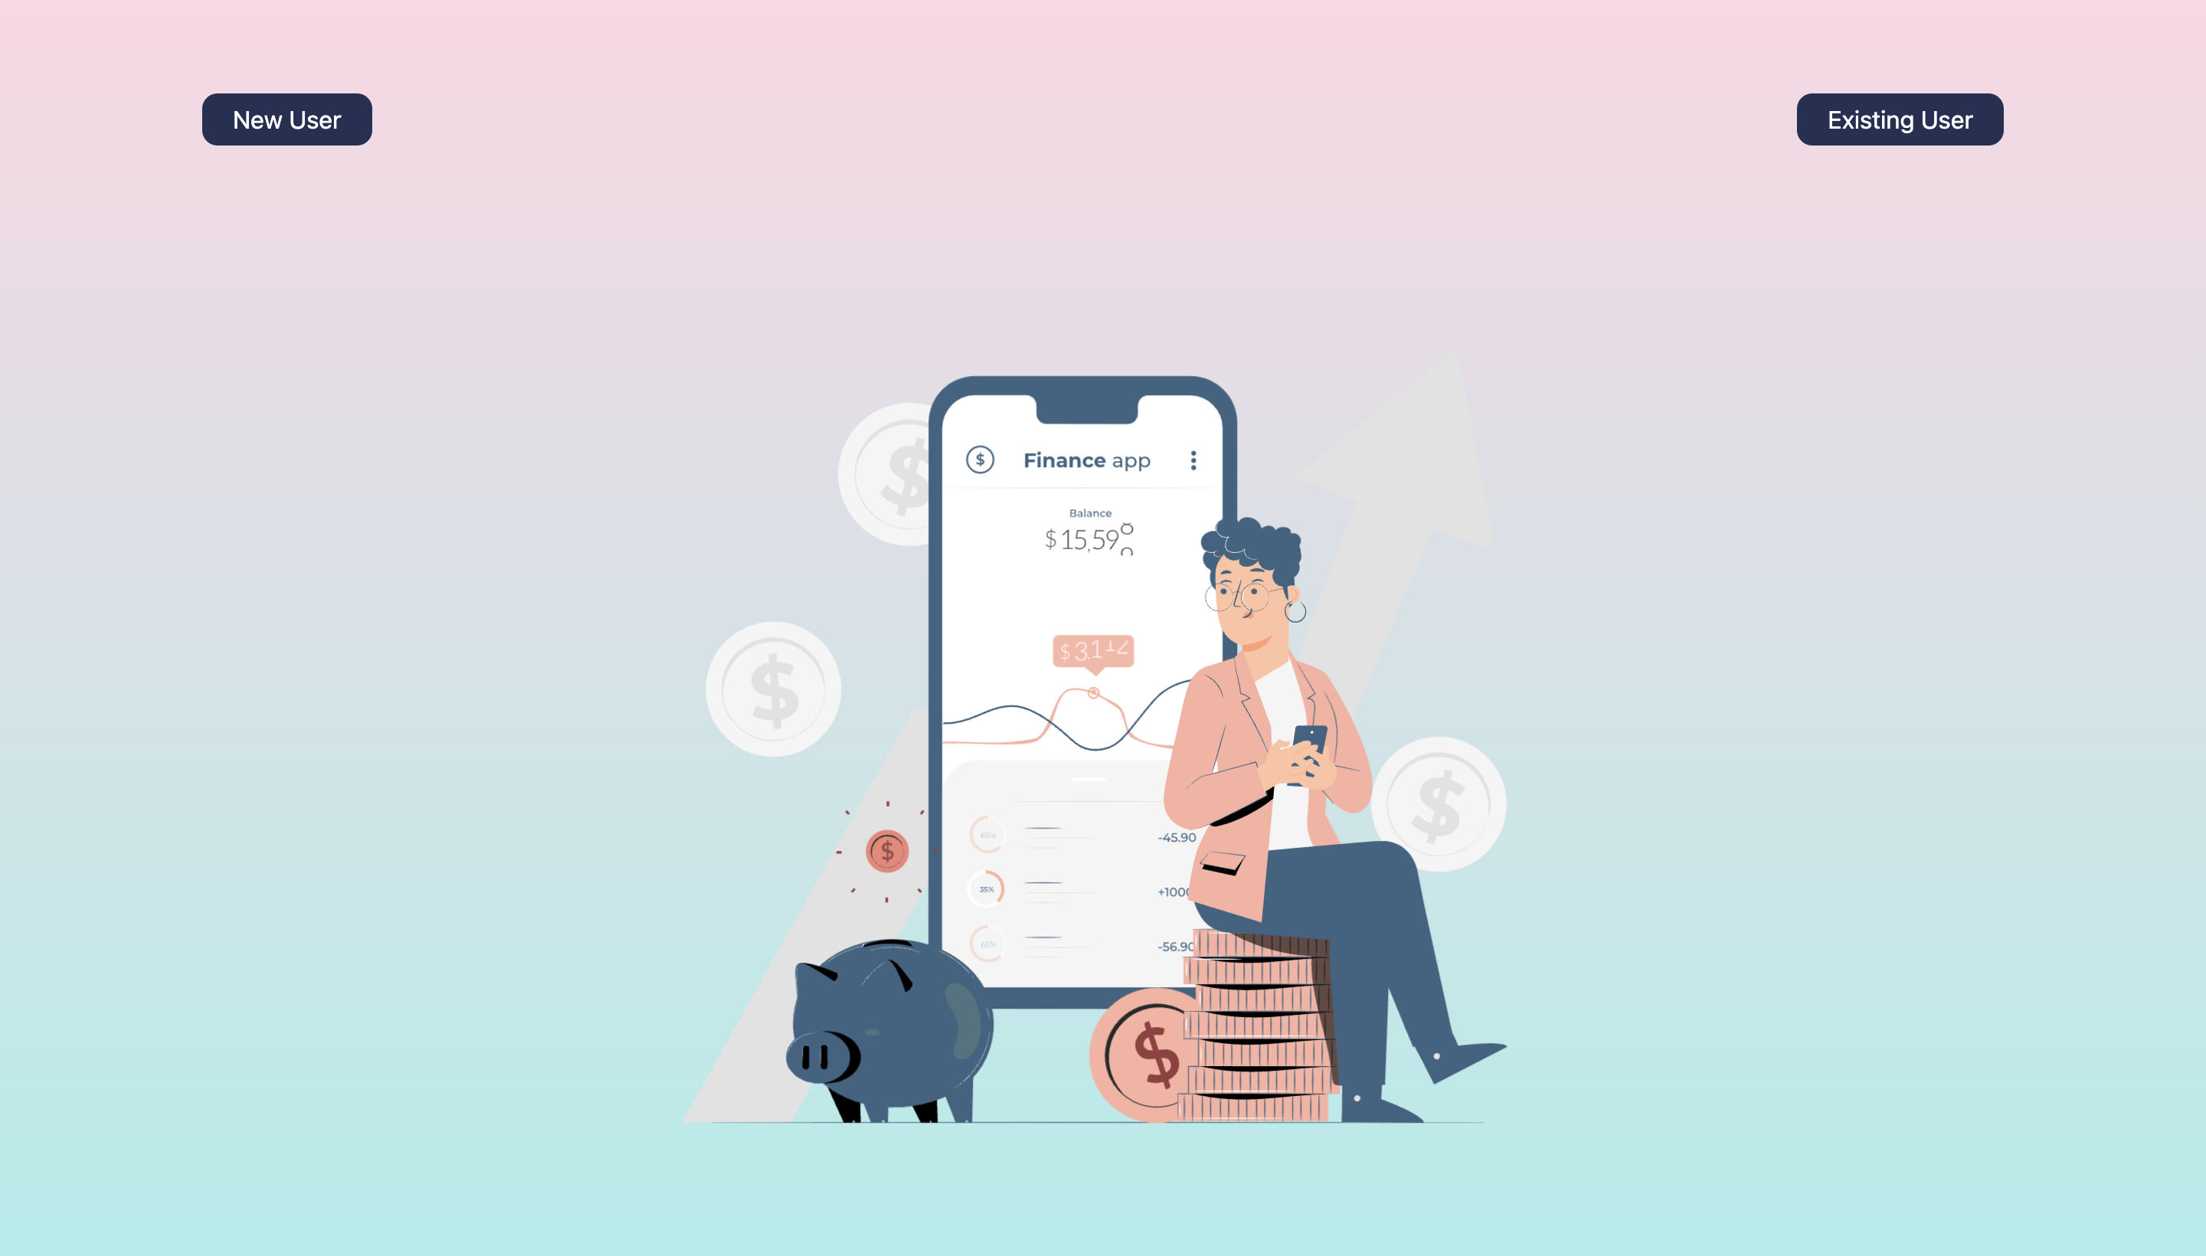
User Registration Page

Slide 9
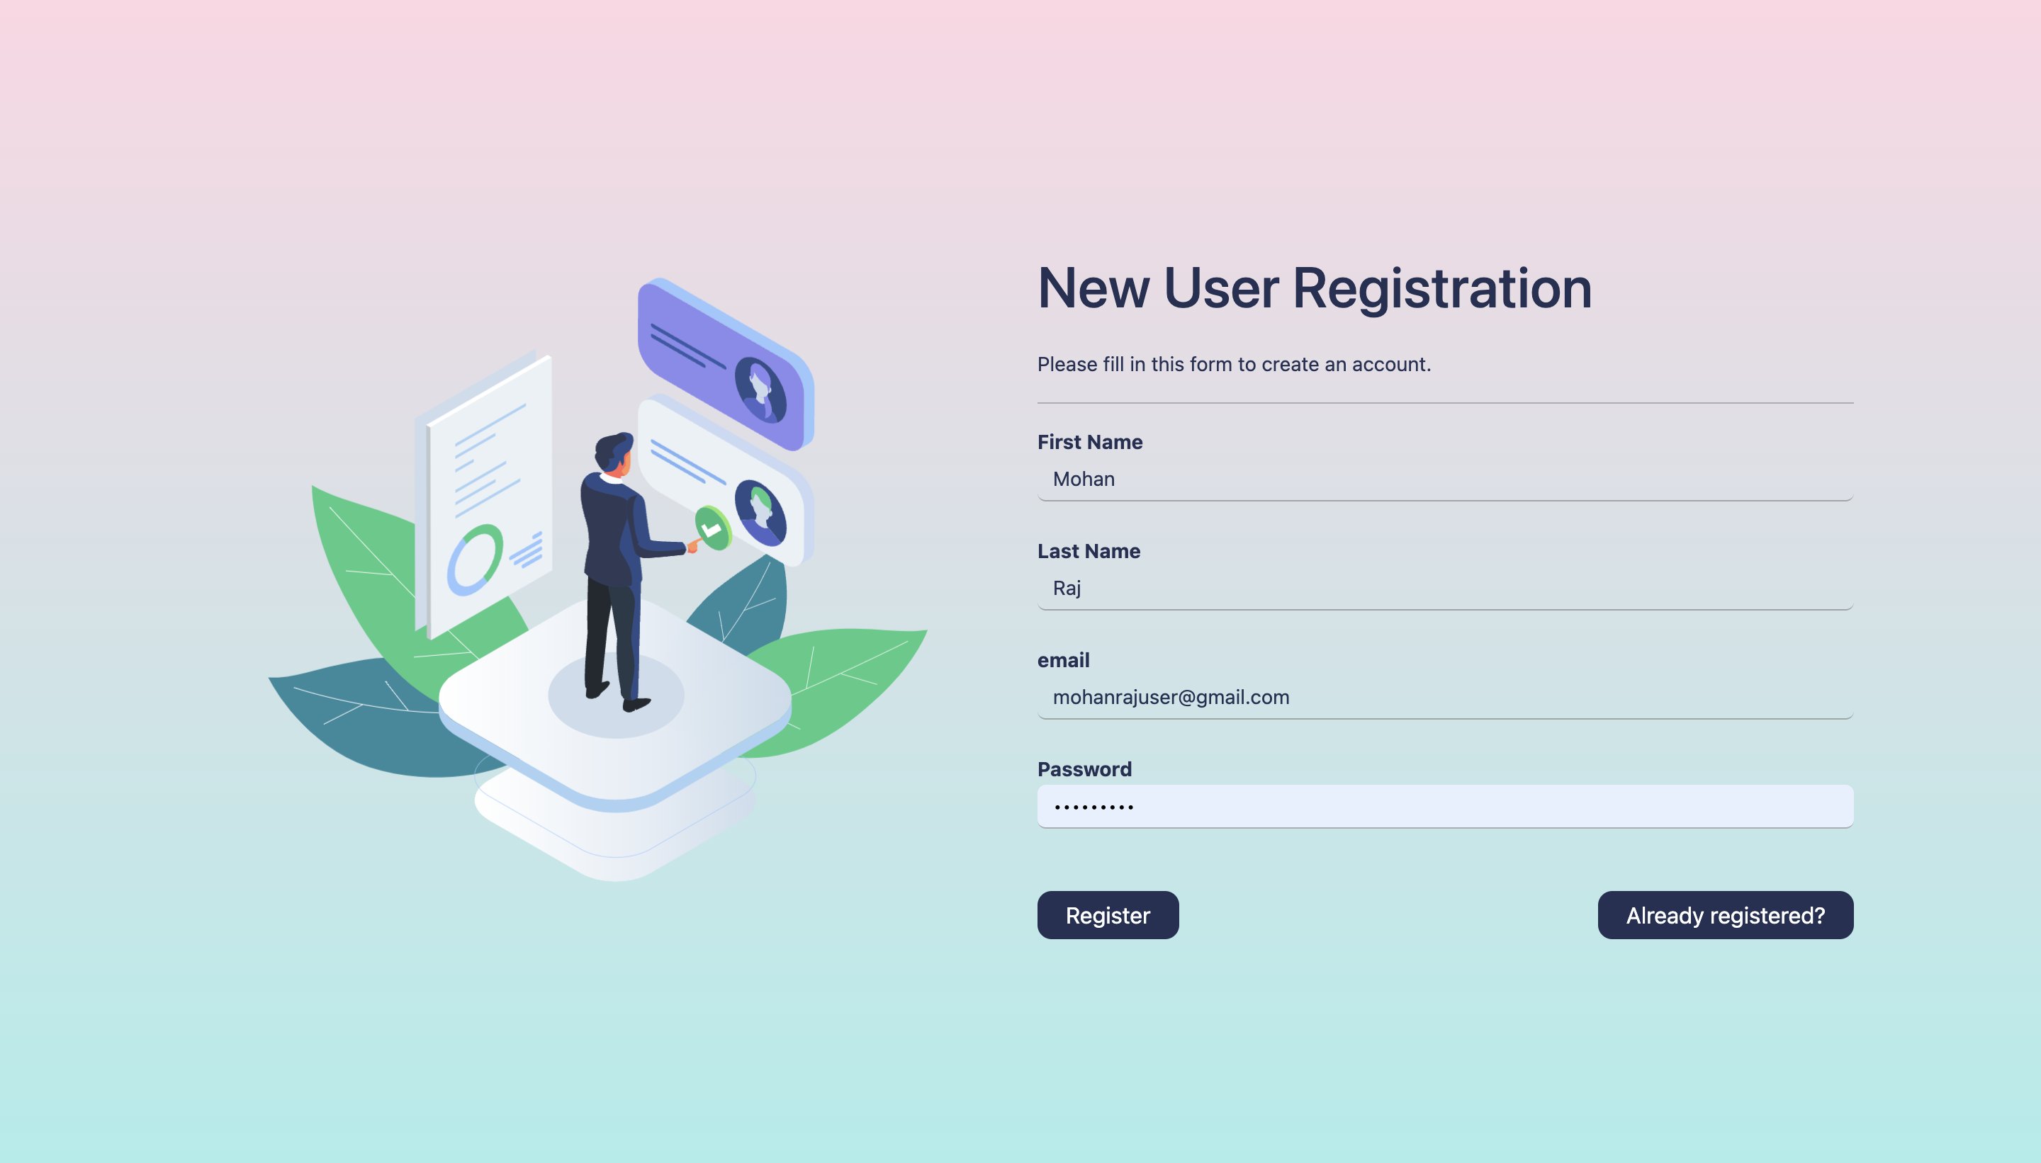
NEW USER REGISTRATION

Slide 10
Selecting Existing User

Slide 11

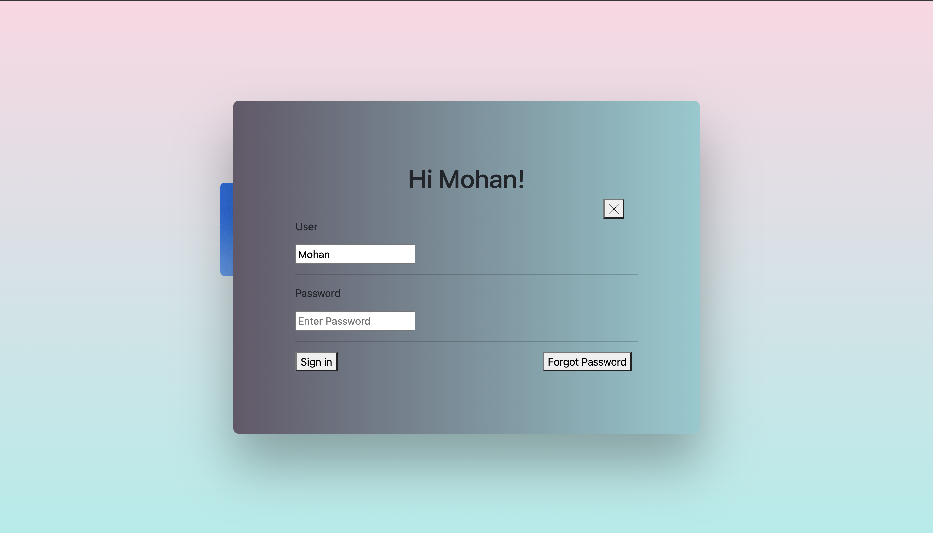
Sign In for Existing User

Slide 12

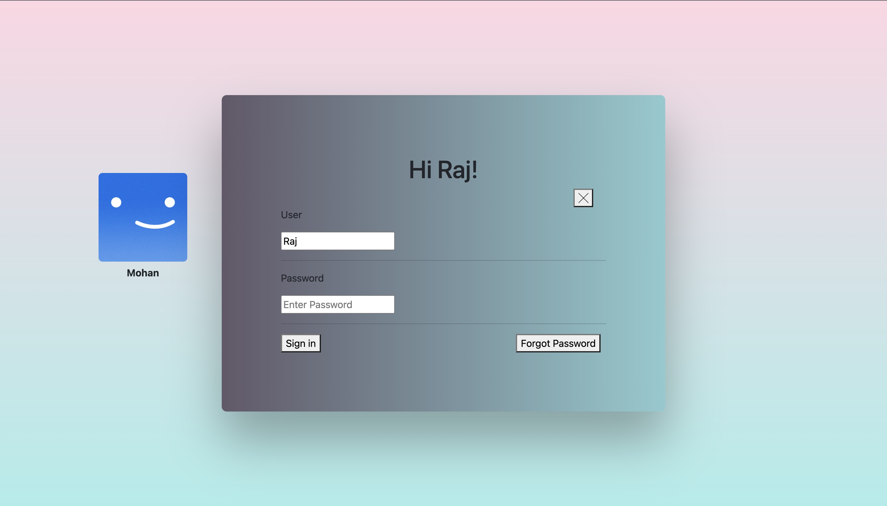
USER SIGN IN

Slide 13
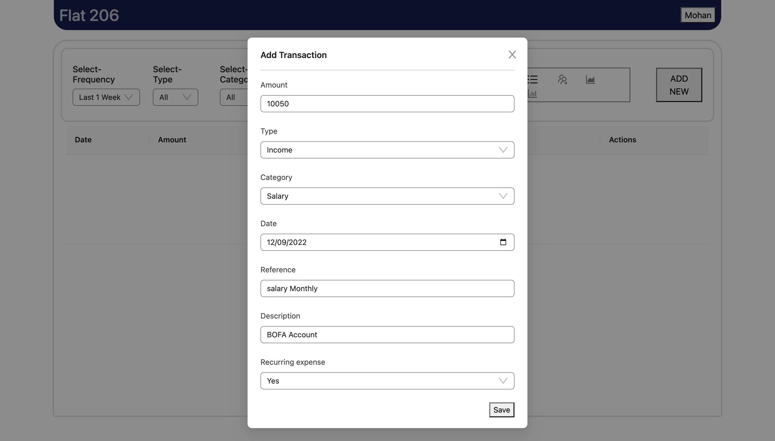

Slide 14
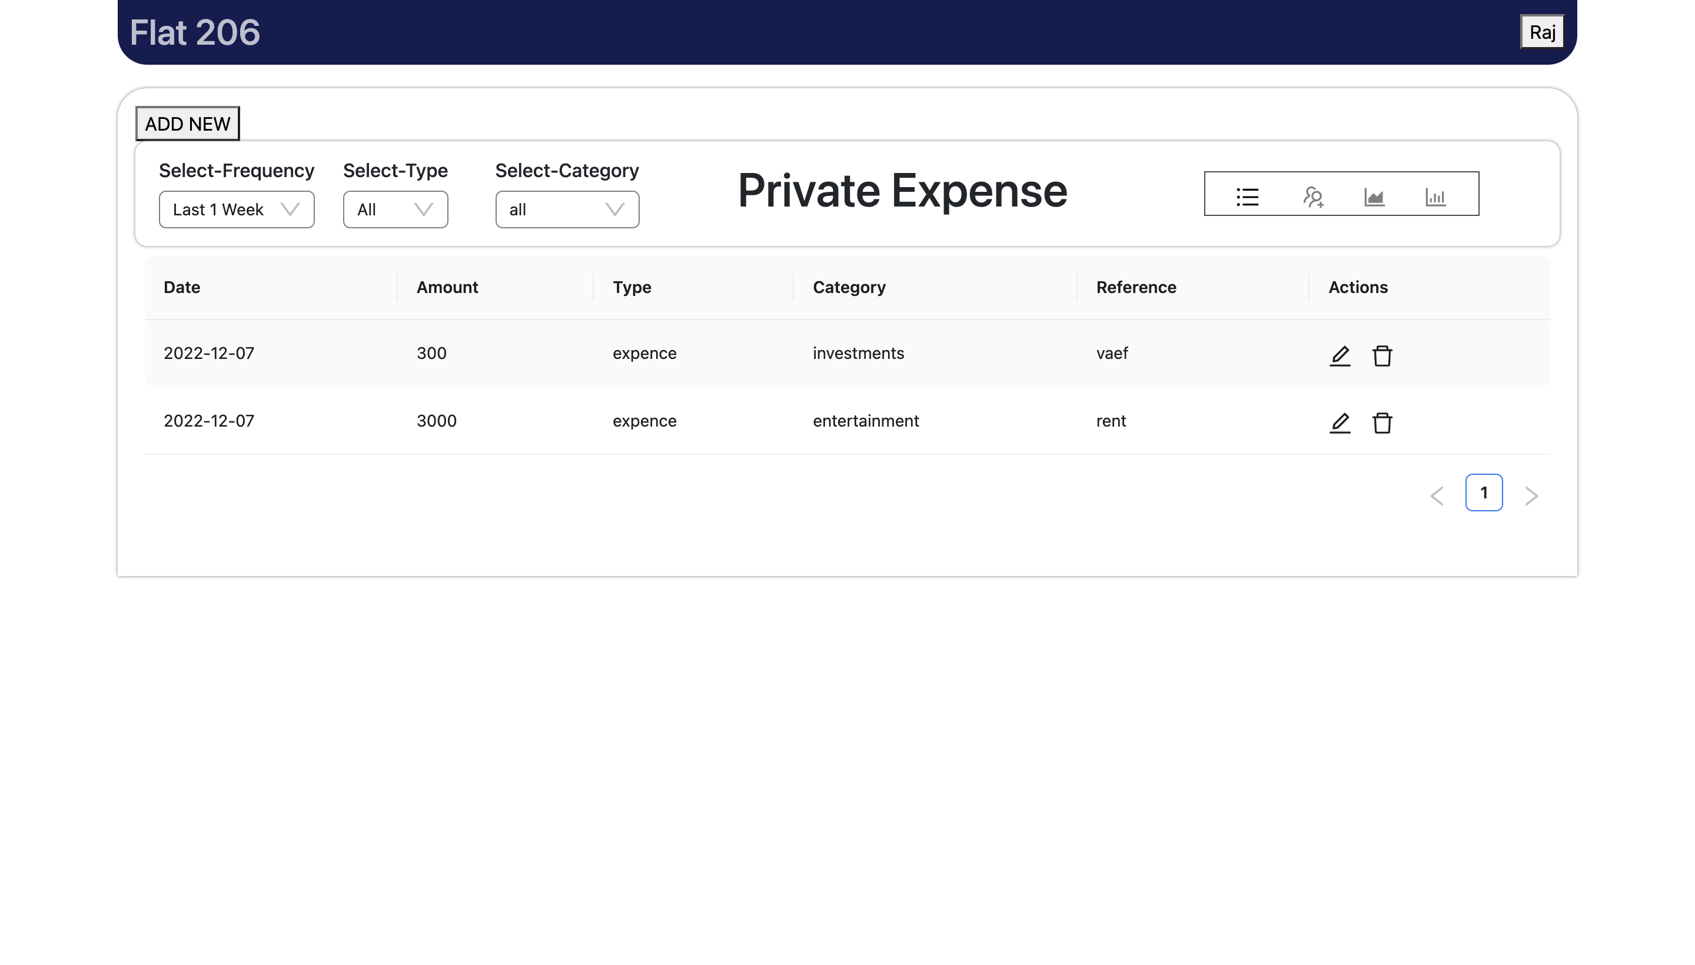
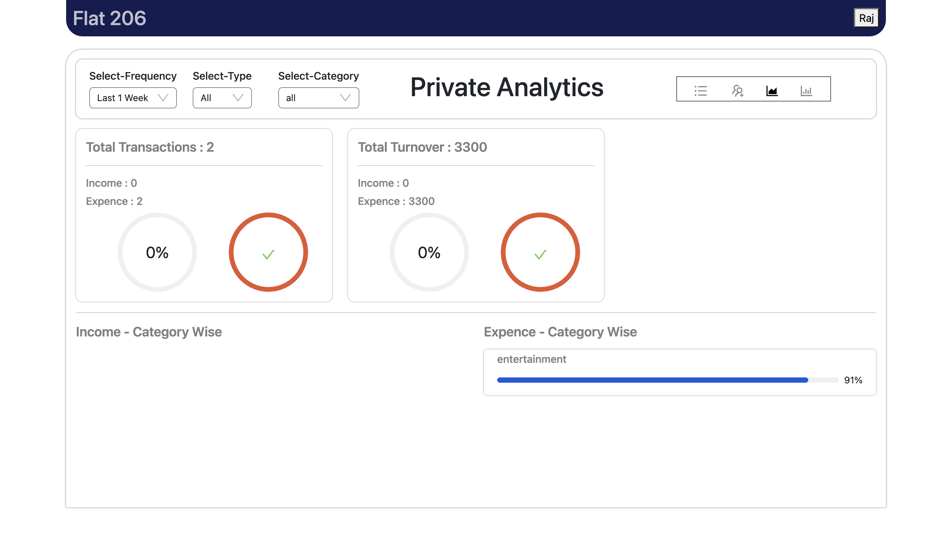
PRIVATE ANALYSIS

Slide 15
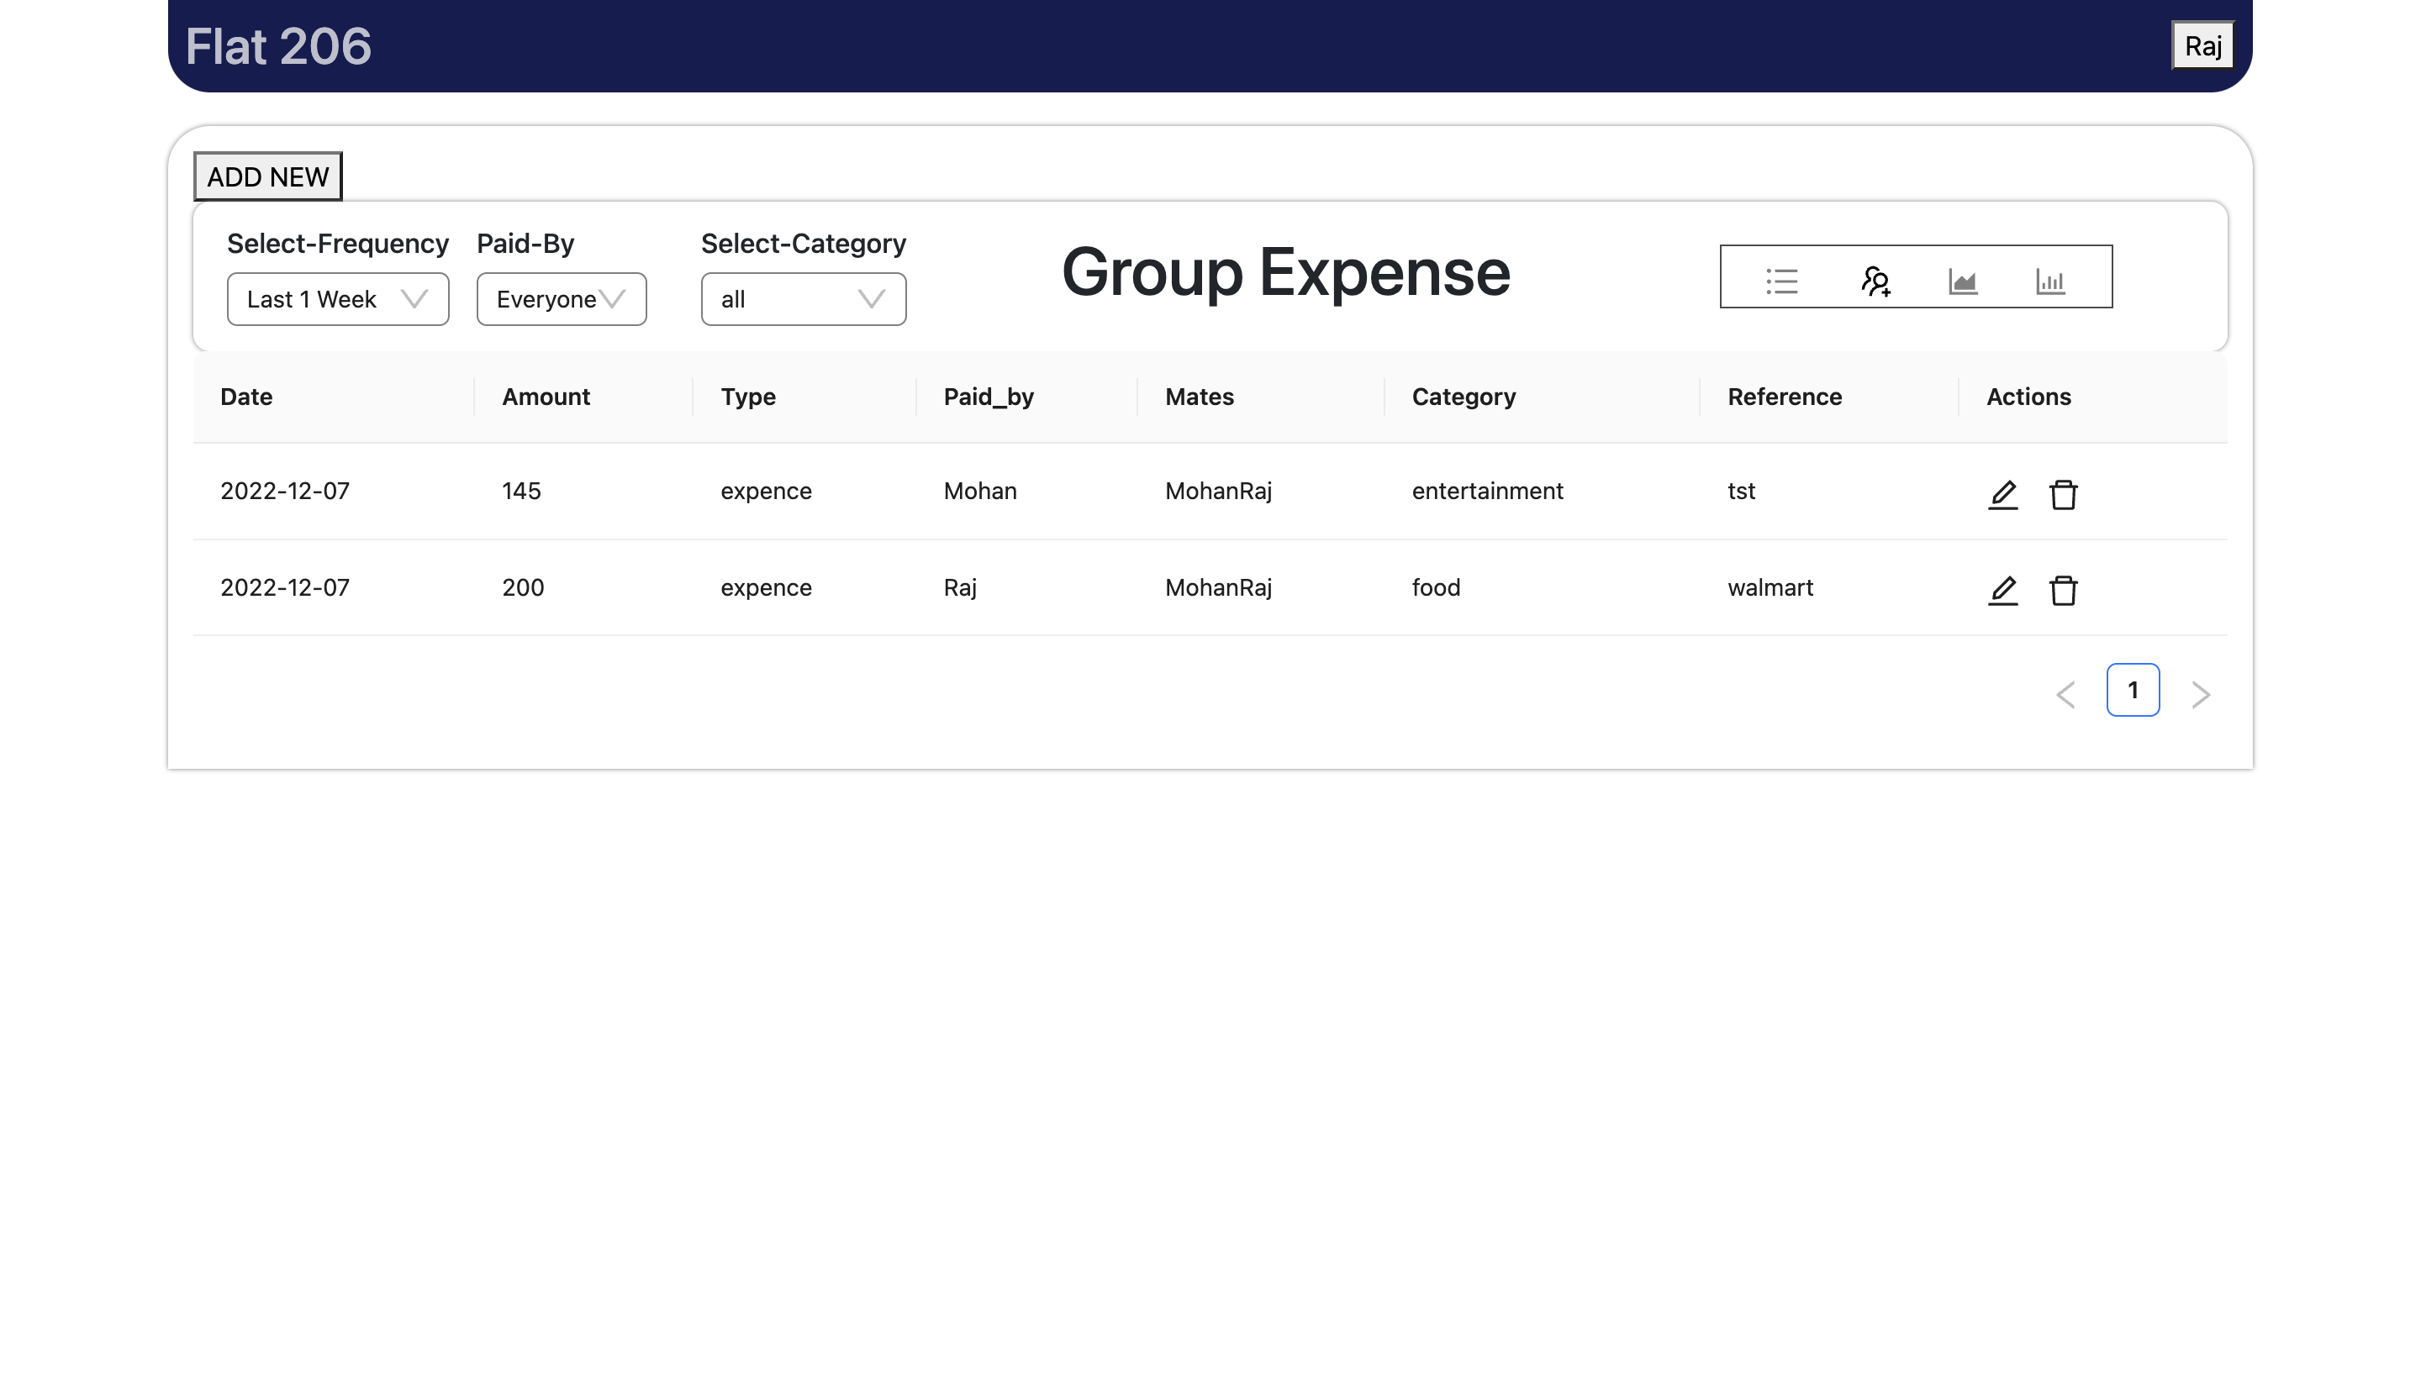
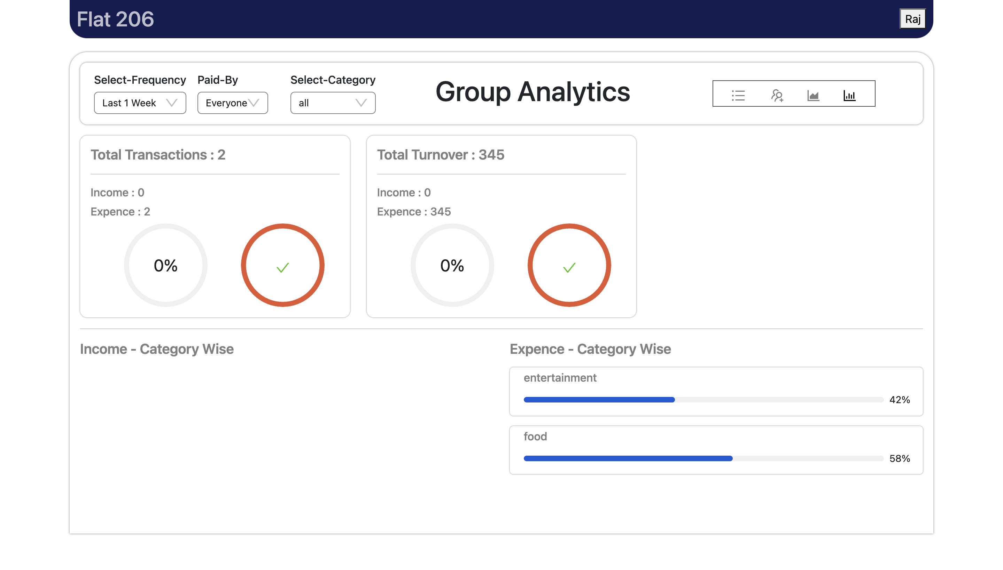
GROUP ANALYSIS

Slide 16
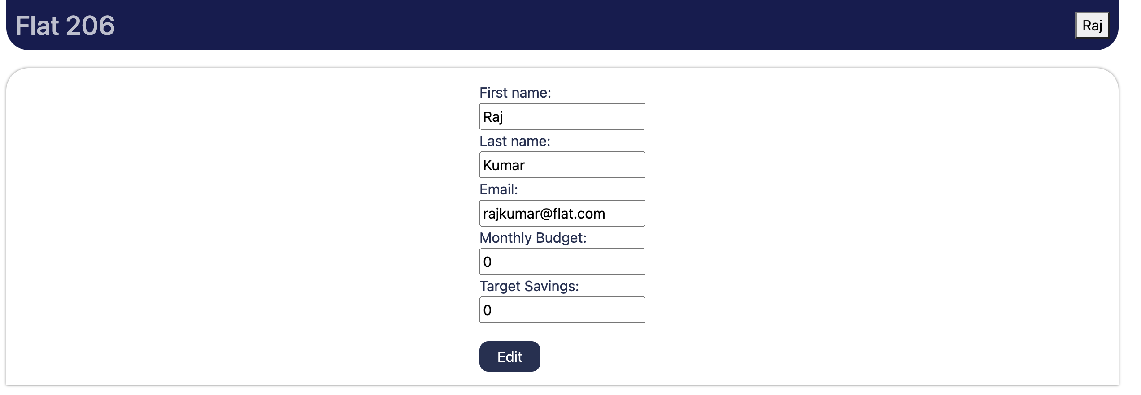
PROFILE PAGE

Slide 17
Future Enhancements
Cloud Deployment
App Integration to track the investment from the stockbroker
Integrating chat among the Flatmates
Integrating payment gateway to pay bills

Slide 18
REFERENCE
https://www.udemy.com/course/mern-stack-expense-tracker-application/
https://github.com/thapatechnical/netflixByThapa

